Slide 1
SmartX

Slide 2
Problem
High energy costs
Loss of potential savings
Managing device usage to reduce costs
Creation and consumption of energy originates asynchronously
Traditional timers are not flexible
Timers don’t care about the current weather/solar panel output
Uneasy to use

Slide 3
Current Solar Energy Produced vs Energy Consumed
Estimated data
Notes:
http://www.solarchoice.net.au/blog/home-energy-consumption-versus-solar-pv-generation/

Slide 4
Idea
Application which optimizes use of solar energy
Informs users of energy generated + optimal usage time + sets schedule

Slide 5
Benefits
Better optimization of solar energy
Allows for users to view amount of available solar energy
Lower electric bills
Better energy distribution

Slide 6
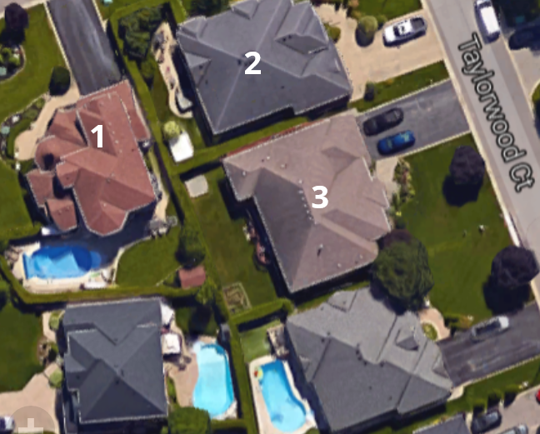
Before and After
 | Family 1 | Family 2 | Family 3
Solar Energy Produced (kW)
Usage of Solar Power Before (kW)
Usage of Solar Power After (kW)

Slide 7
Future Implementations/Dependencies
Devices have to be fully automated to get maximum benefit
Wind energy extension
Global power management

Slide 8
License
This work is licensed under the Creative Commons Attribution 4.0 International License. To view a copy of this license, visit http://creativecommons.org/licenses/by/4.0/ or send a letter to Creative Commons, PO Box 1866, Mountain View, CA 94042, USA.

